Slide 1
Excel Final Reassessment

Slide 2
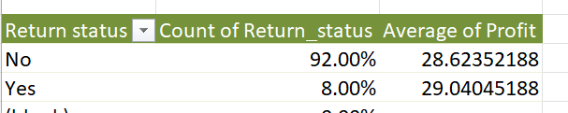
Q1
Total returns reported were 800
and due to this return losses occurred in both sales and revenue fields.
To reduce returns we can check the Quality of products and ensure better delivery services.

Slide 3
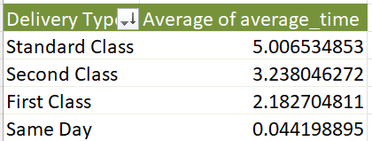
Q2
There are various types of delivery systems according to the choice of customer.
Standard class delivery is the slowest.
Same-day delivery type is the fastest

Slide 4
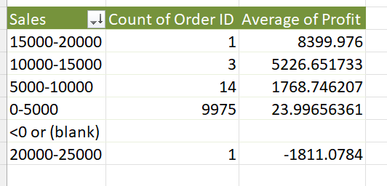
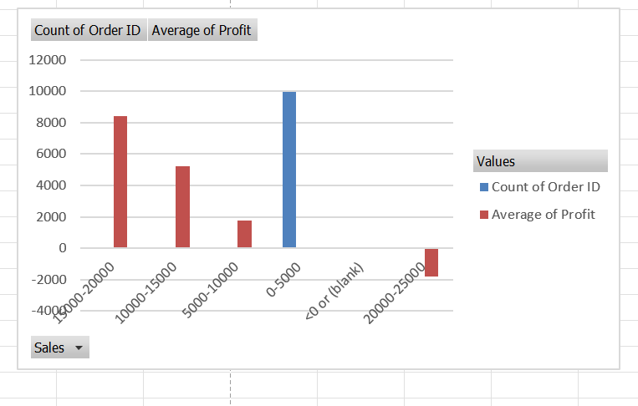
Q3
Profit in the segment is shown from most to least.
And from the chary we can infer the information more easily

Slide 5
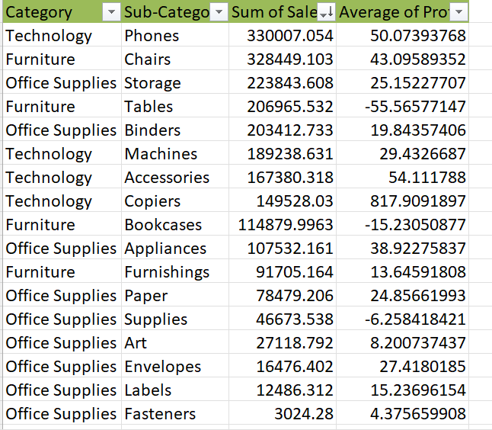
Q4
The top selling category is Technology and the subcategory is phones and just next to them is the Furniture category with the sub-category chairs.
With this analysis, we can conclude that if we focus more on these categories and subcategories we can see a big increase in sales and profit.

Slide 6
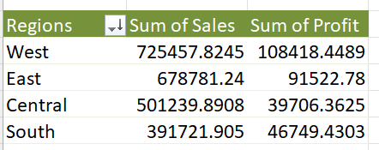
Q5
In the regional analysis we can see that more sales is occurring in west region
South region has the lowest sales .
This also impacts the profit in those regions so we can increase discounts and give more promotions to increase sales in that region

Slide 7
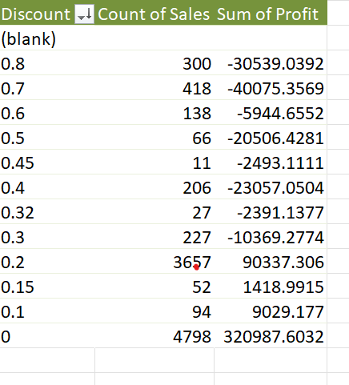
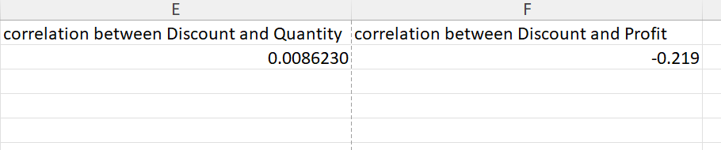
Q6
By giving discount we can see there is an increase in sales but it affects the profit we are making which leads to loss for the association.
correlation between Discount and Quantity:
0.0086
correlation between Discount and profit:
-0.219

Slide 8
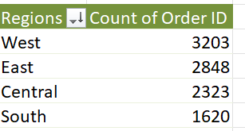
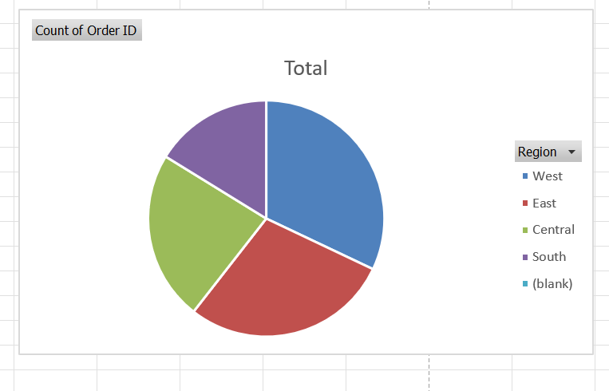
Q7
In market expansion, we created a table where we can analyze where are we getting most of our orders and then we can undertake the necessary steps to expand.
In the pie chart, we can infer that in the western region we can expand as there are high amount of orders and it will help in profitability.

Slide 9
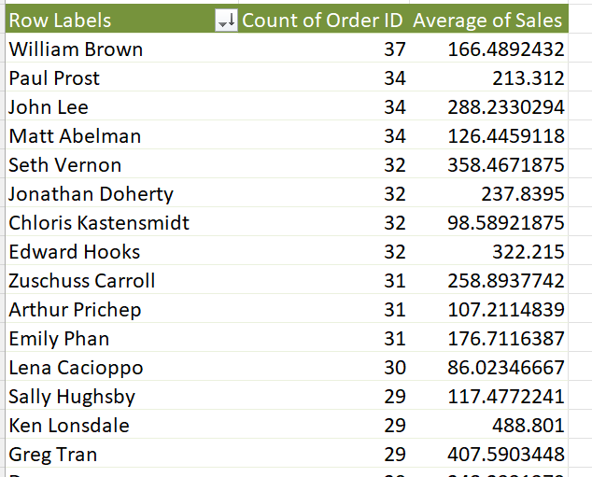
Q8
For customer retention, we created a table with customers and count of their orders and average contribution to the total
Sales.
From that, we can infer that consumers must be targeted with discounts and different types of promotions so that their life cycle increases.

Slide 10
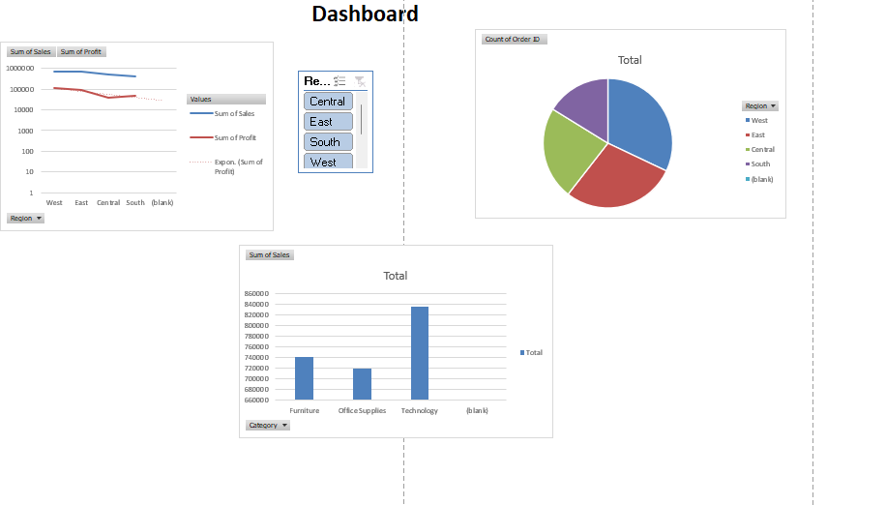
Q9

Slide 11
Q10

